Slide 1
DBMS Second Normal Form

Slide 2
For a table to be in the Second Normal Form, it must satisfy two conditions:
The table should be in the First Normal Form.
There should be no Partial Dependency.
Here partial dependency means the proper subset of candidate key determines a non-prime attribute.
Single Column Primary Key
non-primary keys are fully dependent on primary keys,

Slide 3
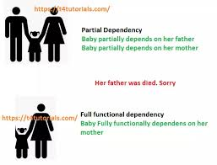

Slide 4
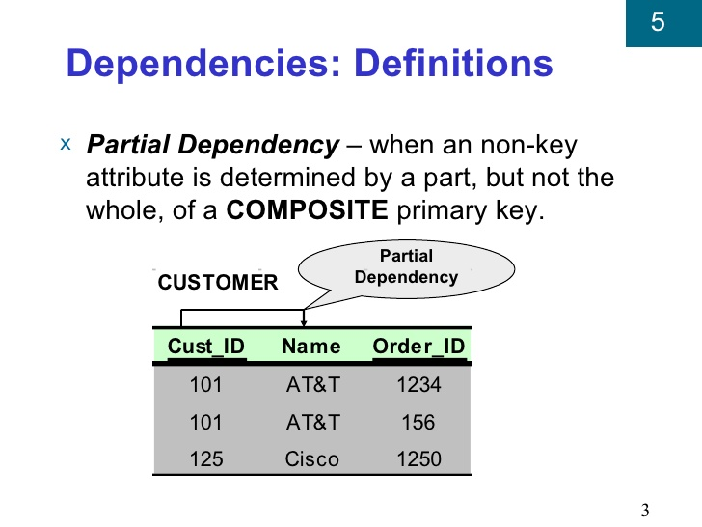

Slide 5
Teacher Table
TEACHER_ID | SUBJECT | TEACHER_AGE
25 | Chemistry | 30
25 | Biology | 30
47 | English | 35
83 | Math | 38
83 | Computer | 38
Teacher_id,subject is my primary key.
Teacher_age is not depend on subject its depend on teacher-id.

Slide 6
In the given table, non-prime attribute TEACHER_AGE is dependent on TEACHER_ID which is a proper subset of a candidate key. That's why it violates the rule for 2NF.
To convert the given table into 2NF, we decompose it into two tables:

Slide 7
TEACHER_ID | TEACHER_AGE
25 | 30
47 | 35
83 | 38
TEACHER_SUBJECT table:
TEACHER_ID | SUBJECT
25 | Chemistry
25 | Biology
47 | English
83 | Math
83 | Computer
TEACHER_DETAIL table:

Slide 8
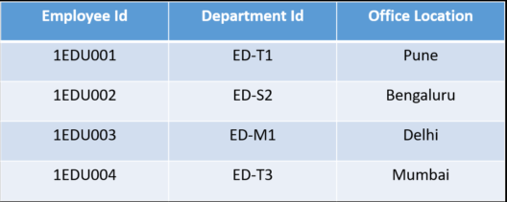
Example 02

Slide 9
This table has a composite primary key Emplyoee ID, Department ID. The non-key attribute is Office Location. In this case, Office Location only depends on Department ID, which is only part of the primary key. Therefore, this table does not satisfy the second Normal Form.
To bring this table to Second Normal Form, we need to break the table into two parts. Which will give us the below tables:

Slide 10
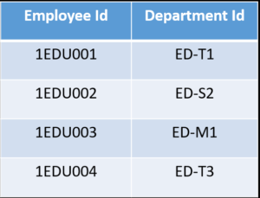
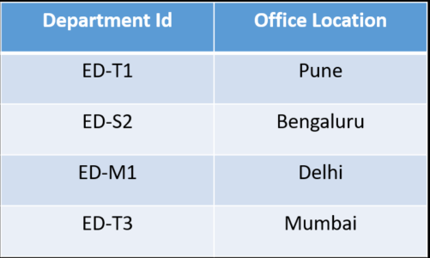

Slide 11
As you can see we have removed the partial functional dependency that we initially had. Now, in the table, the column Office Location is fully dependent on the primary key of that table, which is Department ID.

Slide 12
Example 03
StudentID | ProjectNo | StudentName | ProjectName
S01 | 199 | Katie | Geo Location
S02 | 120 | Ollie | Cluster Exploration

Slide 13
As stated, the non-prime attributes i.e. StudentName and ProjectName should be functionally dependent on part of a candidate key, to be Partial Dependent.
The StudentName can be determined by StudentID, which makes the relation Partial Dependent.
The ProjectName can be determined by ProjectNo, which makes the relation Partial Dependent.
Therefore, the <StudentProject> relation violates the 2NF in Normalization and is considered a bad database design.
To remove Partial Dependency and violation on 2NF, decompose the tables −

Slide 14
StudentID | ProjectNo | StudentName
S01 | 199 | Katie
S02 | 120 | Ollie
ProjectNo | ProjectName
199 | Geo Location
120 | Cluster Exploration

Slide 15
For a table to be in the Second Normal form, it should be in the First Normal form and it should not have Partial Dependency.
Partial Dependency exists, when for a composite primary key, any attribute in the table depends only on a part of the primary key and not on the complete primary key.
To remove Partial dependency, we can divide the table, remove the attribute which is causing partial dependency, and move it to some other table where it fits in well.

Slide 16
Thank you !

